Slide 1

ACT-SYS-DT weekly update - 1

Slide 2
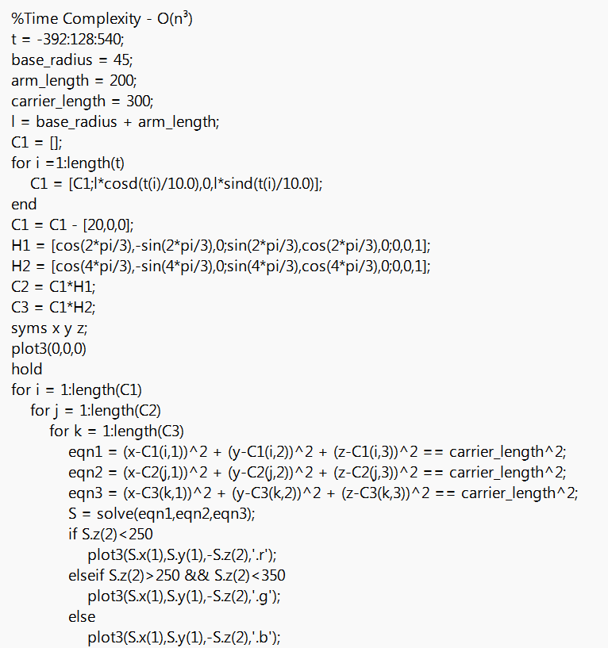
Optimization of Link Length
Problem :
There are three links which acts as the parameter to the Workspace.
Base Radius
Arm
Carrier Stick
Desired workspace is at least 300 X 300.
Solution :
We used MATLAB to code the Forward Kinematics and plot the workspace for various combinations of the link lengths.

Slide 3
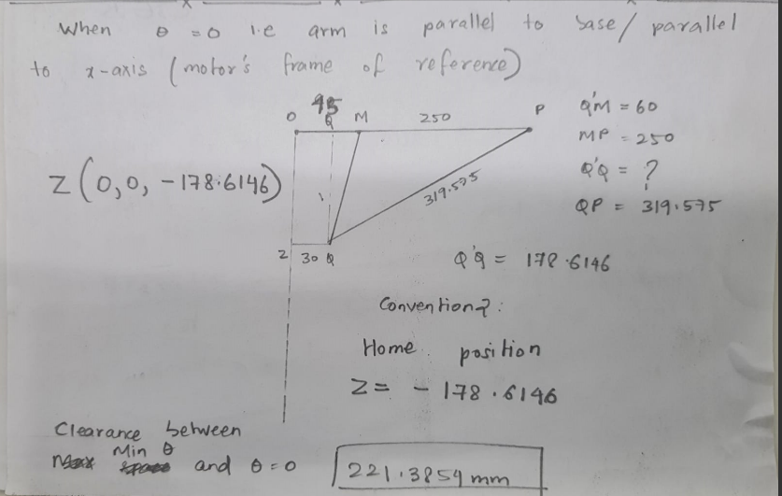
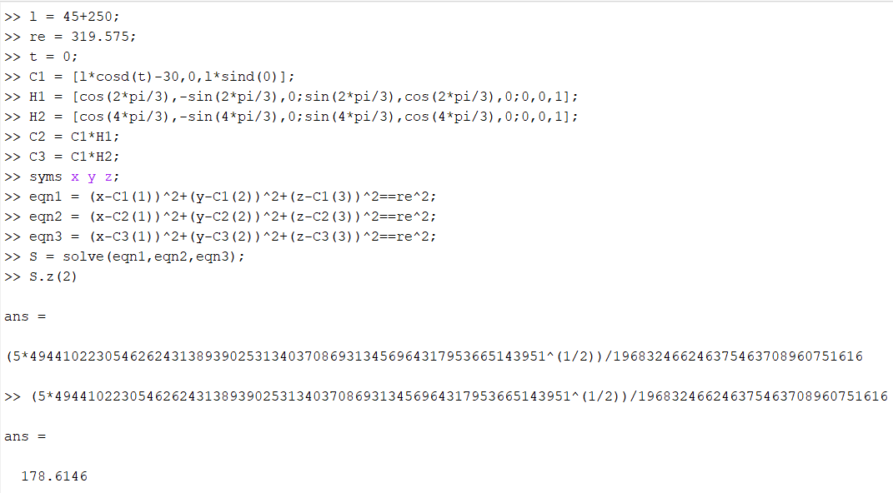
Verification of Algorithm
Calculation of home position for a particular parameters
Analytical solution
Algorithmic solution

Slide 4
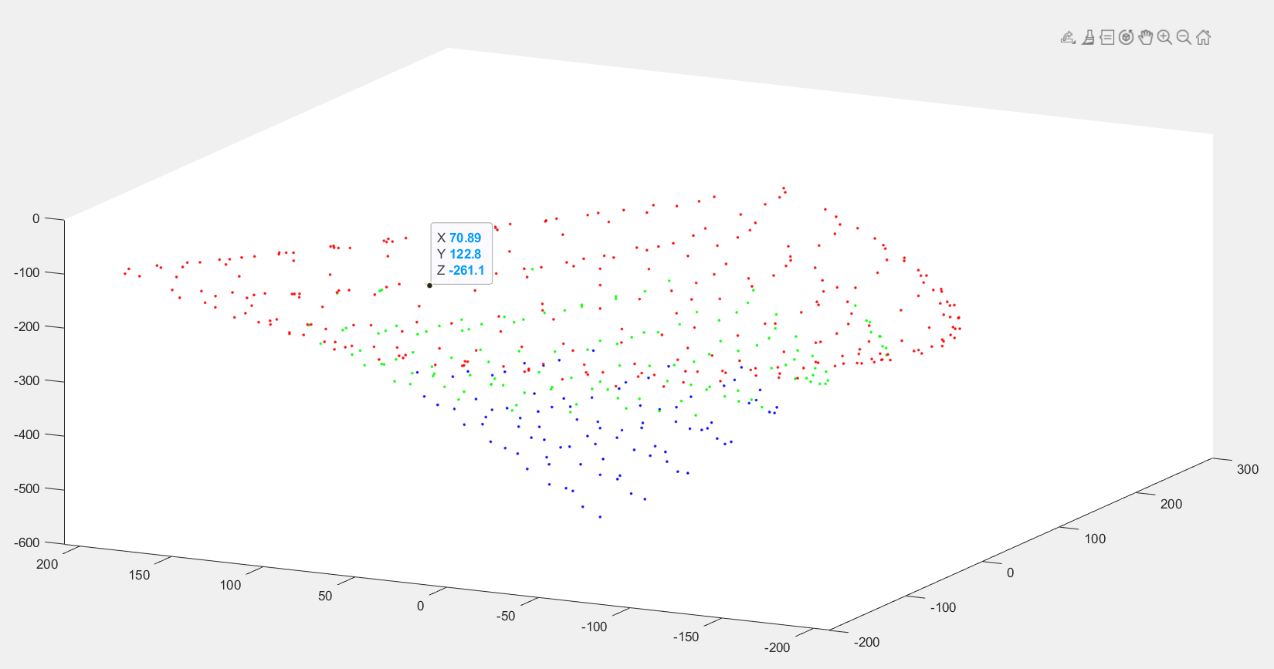
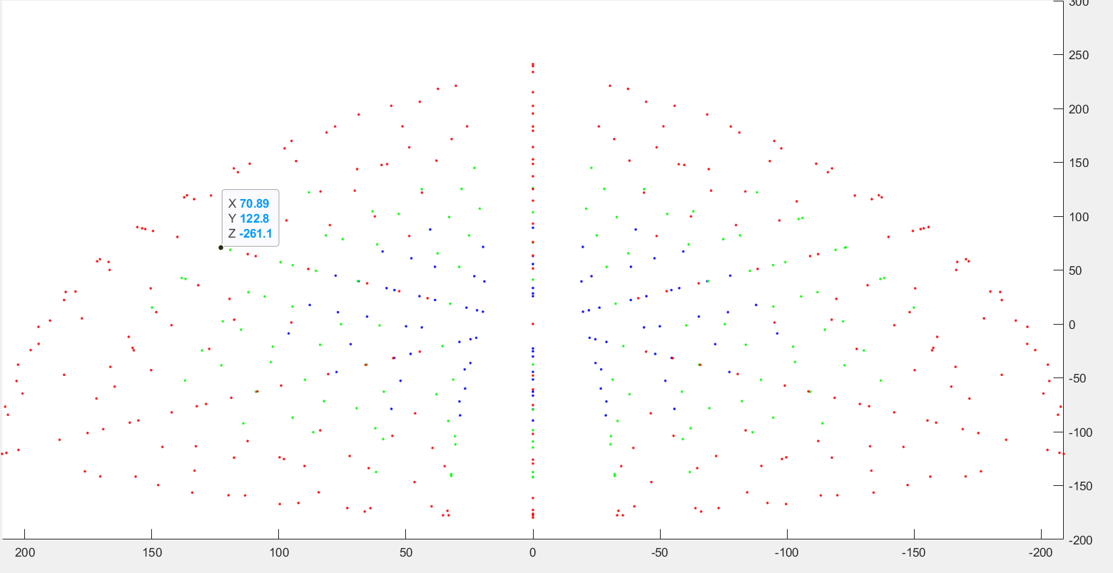
 | Carrier Stick Lengths
 | 300 | 350 | 400
Arm Length | Ratios
150 | 0.5 | 0.428571 | 0.375
200 | 0.666667 | 0.571429 | 0.5
250 | 0.833333 | 0.714286 | 0.625
After running several simulations we found a maximum workspace for the existing space constraint
base_radius = 60
Arm_length = 250
Carrier_length = 400

Slide 5
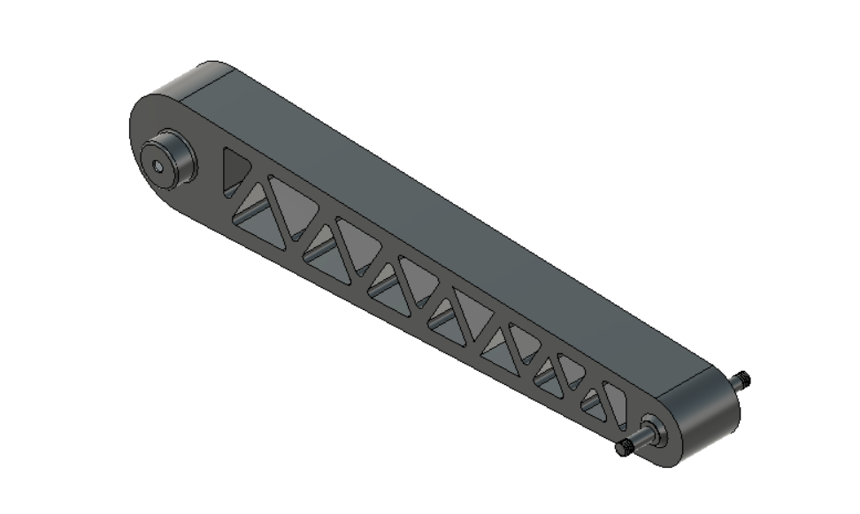
Design of Arm
Assuming hollow square section of thickness 7.5 mm
Stress due to Moment at pulley end ≤ 1.4 MPa
Deflection at carrier end ≤ 0.9196mm
Calculated when a downward load of 2kg acts carrier end
Material Used : ABS
Pulley End
30
Carrier end
7.5
Neutral Axis

Slide 6
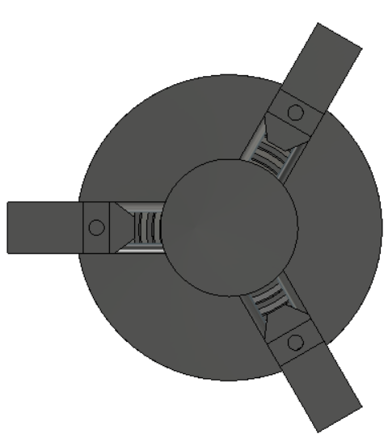
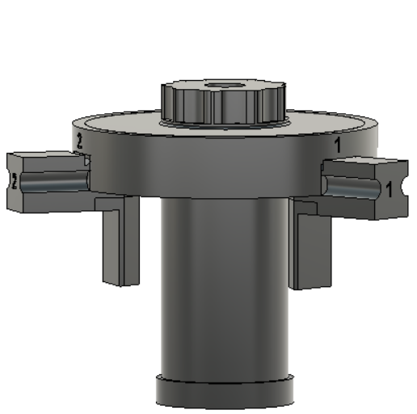
Self Centring Mechanism

Slide 7
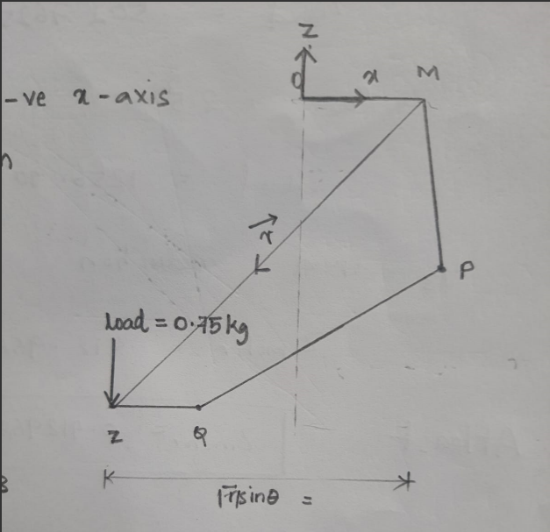
Torque Calculation
Load torque is a function of base radius and maximum traverse distance which in our case should be higher than 150mm.
Assuming max. traverse to be 160mm and for various base radius.
Applied load: 0.75 kg | FOS: 2.5 | Max Load: 1.875kg
FOS | 2 | 2.5 | 3
Base Radius | TORQUE (Nmm)
45 | 1005.525 | 1256.906 | 1508.2875
60 | 1079.1 | 1348.875 | 1618.25
75 | 1152.675 | 1440.843 | 1729.0125
90 | 1226.25 | 1532.8125 | 1839.375

Slide 8
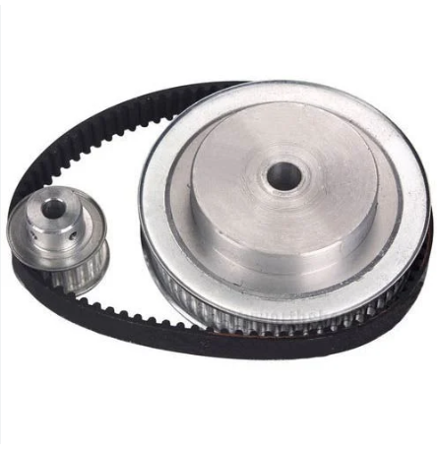
Speed Reduction
Selecting OTS belt drive : 1/3rd speed reduction
The optimum base radius for the required workspace is 60mm
Whose torque requirement is 1348.875 Nmm
Selected motor should generate atleast 450 Nmm considering the speed reduction
Other Components Required
Al Tube - ID6, OD8, L400 – Carrier stick : Shop
POS 6 Rod End Bearing : Shop
Jam/Lock Nuts
Bearing ID8 OD22

Slide 9
Action PLAN for this Week
What | Who | When (completion)
Motor Housing | HARI | 31-01-2023
Fixture for Motor Housing | HARI | 01-02-2023
Work Holder | PRAGADEESH | 31-01-2023
Ideas for Cable Management | TEAM | TBD
Electronics Enclosure | PRAGADEESH | 02-01-2023
Final Assembly | H & P | TBD
3D Printing | H & P | Initializing on 01-02-2023 at MIT
Local Sourcing | H & P

